Slide 1
Electronics Systems (938II)
Lecture 2.1
Building Blocks of Electronic Systems – MUX, DEMUX, XOR, Comparator

Slide 2
Building Blocks of Electronic Systems*
An electronic system is made of combinational and/or sequential circuits
Combinational circuit
Output depends only on the current input(s)
Sequential circuit
Output depends on both the current input(s) and the current state
Current state = previous output → It has memory

Slide 3
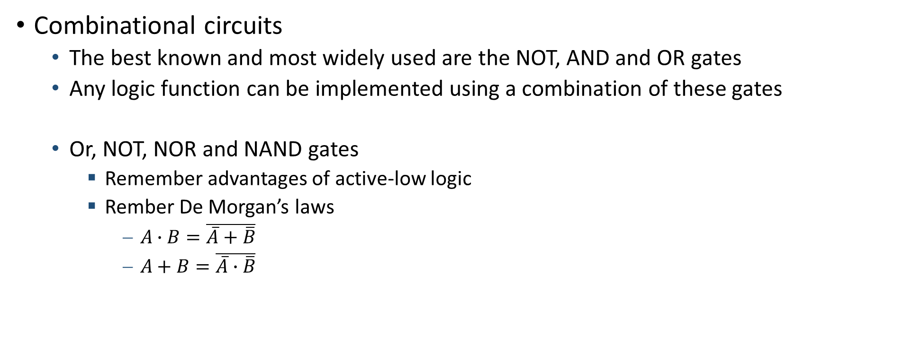
Building Blocks of Electronic Systems*
Combinational circuits
The best known and most widely used are the NOT, AND and OR gates
Any logic function can be implemented using a combination of these gates
Or, NOT, NOR and NAND gates
Remember advantages of active-low logic
Rember De Morgan’s laws
$A∙B=\overline{\overline{A}+\overline{B}}$
$A+B=\overline{\overline{A}∙\overline{B}}$

Slide 4
Building Blocks of Electronic Systems*
Combinational circuits
Other primitives exist
For example, the multiplexer (or MUX)

Slide 5
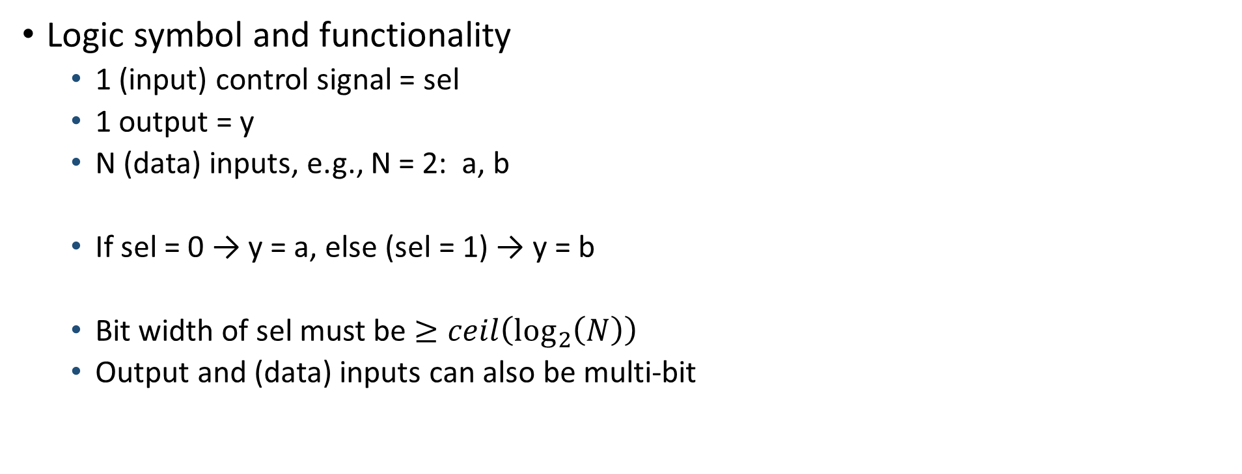
Multiplexer (or MUX)*
Logic symbol and functionality
1 (input) control signal = sel
1 output = y
N (data) inputs, e.g., N = 2: a, b
If sel = 0 → y = a, else (sel = 1) → y = b
Bit width of sel must be $≥ceil\left(\log_{2}\left(N\right)\right)$
Output and (data) inputs can also be multi-bit
a
0
y
b
1
sel

Slide 6

Multiplexer (or MUX)*
Gate-level circuit
If sel = 0 → y = a, else (sel = 1) → y = b
$$y=a∙\overline{sel}+b∙sel$$
a
0
y
b
1
sel

Slide 7

Multiplexer (or MUX)*
Gate-level circuit
If sel = 0 → y = a, else (sel = 1) → y = b
$$y=a∙\overline{sel}+b∙sel$$
a
0
y
b
1
sel

Slide 8

Multiplexer (or MUX)*
Gate-level circuit
If sel = 0 → y = a, else (sel = 1) → y = b
$$y=a∙\overline{sel}+b∙sel$$
a
0
y
b
1
sel

Slide 9



Multiplexer (or MUX)*
Gate-level circuit
If sel = 0 → y = a, else (sel = 1) → y = b
$$y=a∙\overline{sel}+b∙sel$$
a
0
y
b
1
sel

Slide 10
Multiplexer (or MUX)*
Gate-level circuit
If sel = 0 → y = a, else (sel = 1) → y = b
$$y=a∙\overline{sel}+b∙sel$$
(NAND gate-based)
a
0
y
b
1
sel

Slide 11

Multiplexer (or MUX)*
Gate-level circuit
If sel = 0 → y = a, else (sel = 1) → y = b
$$y=a∙\overline{sel}+b∙sel$$
(NAND gate-based)
a
0
y
b
1
sel

Slide 12
Multiplexer (or MUX)*
Gate-level circuit
If sel = 0 → y = a, else (sel = 1) → y = b
$$y=a∙\overline{sel}+b∙sel$$
(NAND gate-based)
a
0
y
b
1
sel

Slide 13
Multiplexer (or MUX)*
Gate-level circuit
If sel = 0 → y = a, else (sel = 1) → y = b
$$y=a∙\overline{sel}+b∙sel$$
(NAND gate-based)
a
0
y
b
1
sel

Slide 14



Multiplexer (or MUX)*
Gate-level circuit
If sel = 0 → y = a, else (sel = 1) → y = b
$$y=a∙\overline{sel}+b∙sel$$
(NAND gate-based)
a
0
y
b
1
sel

Slide 15


Multiplexer (or MUX)*
Gate-level circuit
If sel = 0 → y = a, else (sel = 1) → y = b
$$y=a∙\overline{sel}+b∙sel$$
(NAND gate-based)
a
0
y
b
1
sel

Slide 16
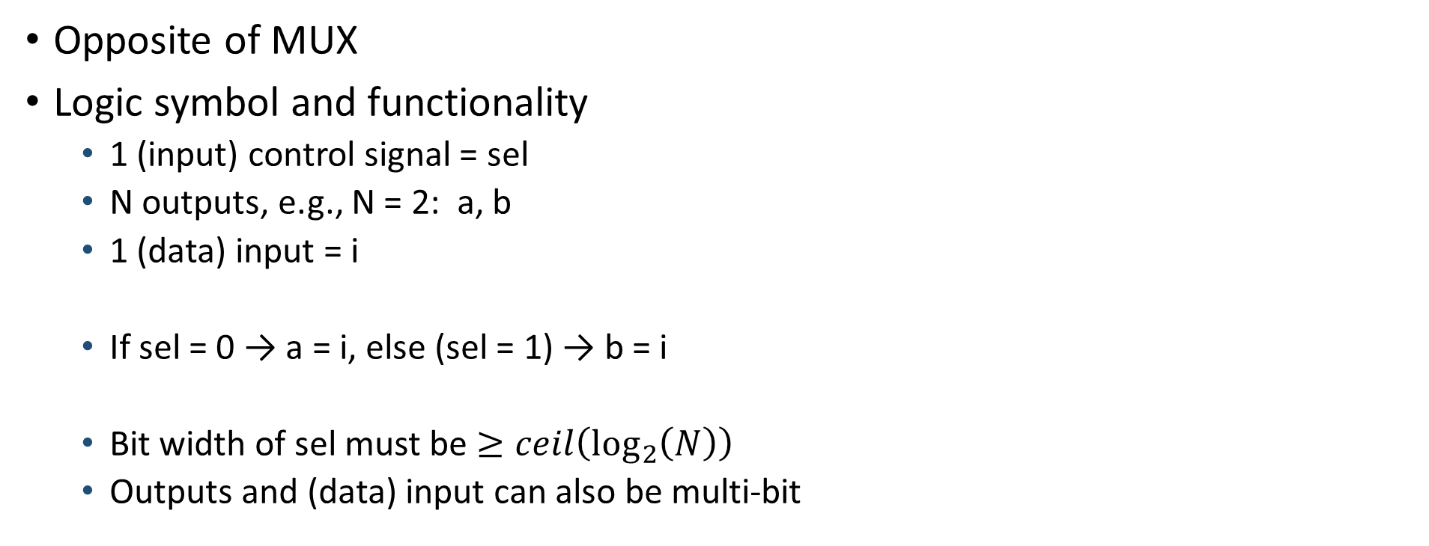
Demultiplexer (or DEMUX)*
Opposite of MUX
Logic symbol and functionality
1 (input) control signal = sel
N outputs, e.g., N = 2: a, b
1 (data) input = i
If sel = 0 → a = i, else (sel = 1) → b = i
Bit width of sel must be $≥ceil\left(\log_{2}\left(N\right)\right)$
Outputs and (data) input can also be multi-bit
a
0
a
i
i
b
1
b
sel
sel

Slide 17
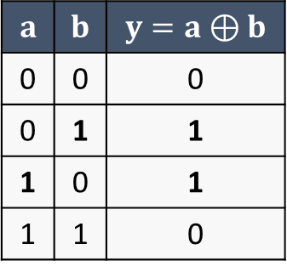

XOR (or exclusive-OR)*
Description
Two inputs
One output
Functionality
One input or the other one is equal to (logic) 1
Exclusive OR (one or the other)
Boolean symbol: $⊕$
Truth table
$$a$$ | $$b$$ | $$y=a⊕b$$
0 | 0 | 0
0 | 1 | 1
1 | 0 | 1
1 | 1 | 0

Slide 18
XOR (or exclusive-OR)*
Another single-gate logical function
Logic symbol = gate-level symbol
(gate-level = logic symbol)

Slide 19
XOR (or exclusive-OR)
Another single-gate logical function
Logic symbol = gate-level symbol
(gate-level = logic symbol)
(transistor-level)

Slide 20
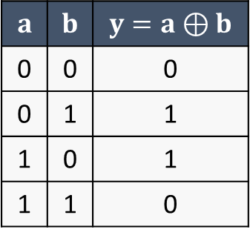
XOR (or exclusive-OR)
Let’s verify it works
Truth table
$$a$$ | $$b$$ | $$y=a⊕b$$
0 | 0 | 0
0 | 1 | 1
1 | 0 | 1
1 | 1 | 0
(transistor-level)

Slide 21
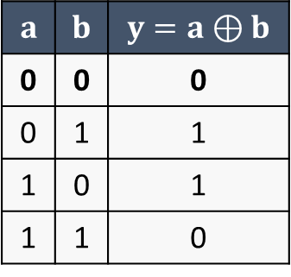
XOR (or exclusive-OR)
Let’s verify it works
Truth table
$$a$$ | $$b$$ | $$y=a⊕b$$
0 | 0 | 0
0 | 1 | 1
1 | 0 | 1
1 | 1 | 0
(transistor-level)

Slide 22
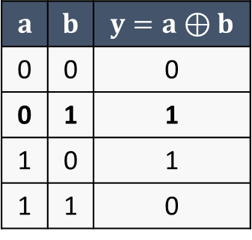
XOR (or exclusive-OR)
Let’s verify it works
Truth table
$$a$$ | $$b$$ | $$y=a⊕b$$
0 | 0 | 0
0 | 1 | 1
1 | 0 | 1
1 | 1 | 0
(transistor-level)

Slide 23
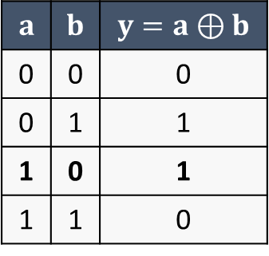

XOR (or exclusive-OR)
Let’s verify it works
Truth table
$$a$$ | $$b$$ | $$y=a⊕b$$
0 | 0 | 0
0 | 1 | 1
1 | 0 | 1
1 | 1 | 0
(transistor-level)

Slide 24
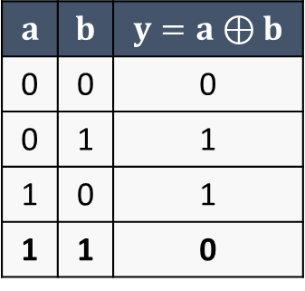
XOR (or exclusive-OR)
Let’s verify it works
Truth table
$$a$$ | $$b$$ | $$y=a⊕b$$
0 | 0 | 0
0 | 1 | 1
1 | 0 | 1
1 | 1 | 0
(transistor-level)

Slide 25

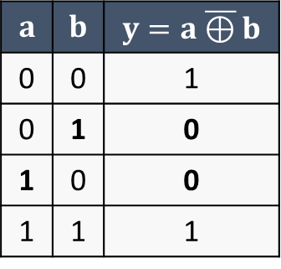
XNOR (or exclusive-NOR)*
Logical complement of XOR
Boolean symbol: $\overline{⊕}$
Another single-gate logical function
Logic symbol = gate-level symbol
$$a$$ | $$b$$ | $$y=a\overline{⊕}b$$
0 | 0 | 1
0 | 1 | 0
1 | 0 | 0
1 | 1 | 1
Truth table
(gate-level)
(transistor-level)

Slide 26

XNOR (or exclusive-NOR)
Logical complement of XOR
Boolean symbol: $\overline{⊕}$
Another single-gate logical function
Logic symbol = gate-level symbol
$$a$$ | $$b$$ | $$y=a\overline{⊕}b$$
0 | 0 | 1
0 | 1 | 0
1 | 0 | 0
1 | 1 | 1
Truth table
(gate-level)
(transistor-level)

Slide 27
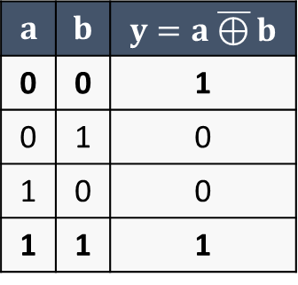
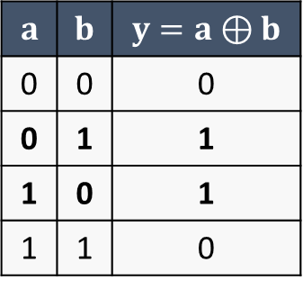
Comparator*
Looking at the truth table of the XOR (or XNOR) function, essentially it indicates if inputs are different (or equal)
XOR truth table
XNOR truth table
$$a$$ | $$b$$ | $$y=a⊕b$$
0 | 0 | 0
0 | 1 | 1
1 | 0 | 1
1 | 1 | 0
$$a$$ | $$b$$ | $$y=a\overline{⊕}b$$
0 | 0 | 1
0 | 1 | 0
1 | 0 | 0
1 | 1 | 1
1 when inputs are different
1 when inputs are equal

Slide 28
Comparator*
Looking at the truth table of the XOR (or XNOR) function, essentially it indicates if inputs are different (or equal)
XOR truth table
XNOR truth table
$$a$$ | $$b$$ | $$y=a⊕b$$
0 | 0 | 0
0 | 1 | 1
1 | 0 | 1
1 | 1 | 0
$$a$$ | $$b$$ | $$y=a\overline{⊕}b$$
0 | 0 | 1
0 | 1 | 0
1 | 0 | 0
1 | 1 | 1
Can be used to build comparators
check if two vectors (single-bit or multi-bit) are different (or equal)
1 when inputs are different
1 when inputs are equal

Slide 29
Comparator*
Parallel version: DIFF = 1, if inputs are different (otherwise 0)
1-bit comparator
4-bit comparator

Slide 30
Comparator*
Parallel version: DIFF = 1, if inputs are different (otherwise 0)
Inputs
a = {a₃ a₂ a₁ a₀}
b = {b₃ b₂ b₁ b₀}
Example
a = {1101}
b = {1101}
4-bit comparator

Slide 31
Comparator*
Parallel version: DIFF = 1, if inputs are different (otherwise 0)
Inputs
a = {a₃ a₂ a₁ a₀}
b = {b₃ b₂ b₁ b₀}
Example
a = {1101}
b = {1011}
4-bit comparator

Slide 32
Comparator*
Iterative (or sequential) version: EQ = 1, if inputs are equal
n-bit comparator

Slide 33

Comparator*
Iterative (or sequential) version: EQ = 1, if inputs are equal
n-bit comparator
CMP

Slide 34
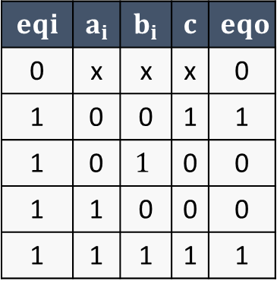
Comparator*
Iterative (or sequential) version: EQ = 1, if inputs are equal
CMP truth table
n-bit comparator
$$eqi$$ | $$a_{i}$$ | $$b_{i}$$ | $$c$$ | $$eqo$$
0 | x | x | x | 0
1 | 0 | 0 | 1 | 1
1 | 0 | $$1$$ | 0 | 0
1 | 1 | 0 | 0 | 0
1 | 1 | 1 | 1 | 1
CMP

Slide 35







Comparator*
Iterative (or sequential) version: EQ = 1, if inputs are equal
Example: 4-bit comparator
a = {1101}
b = {1101}
CMP truth table
$$eqi$$ | $$a_{i}$$ | $$b_{i}$$ | $$c$$ | $$eqo$$
0 | x | x | x | 0
1 | 0 | 0 | 1 | 1
1 | 0 | $$1$$ | 0 | 0
1 | 1 | 0 | 0 | 0
1 | 1 | 1 | 1 | 1

Slide 36







Comparator*
Iterative (or sequential) version: EQ = 1, if inputs are equal
Example: 4-bit comparator
a = {1101}
b = {1011}
CMP truth table
$$eqi$$ | $$a_{i}$$ | $$b_{i}$$ | $$c$$ | $$eqo$$
0 | x | x | x | 0
1 | 0 | 0 | 1 | 1
1 | 0 | $$1$$ | 0 | 0
1 | 1 | 0 | 0 | 0
1 | 1 | 1 | 1 | 1

Slide 37


Comparator*
Iterative (or sequential) version: EQ = 1, if inputs are equal
For very long n-bit input vectors (i.e. n is very high), it may reduce resource consumption
But very long path/delay

Slide 38
Exercise with SystemVerilog
Implementation of a MUX and simulation with Modelsim

Slide 39
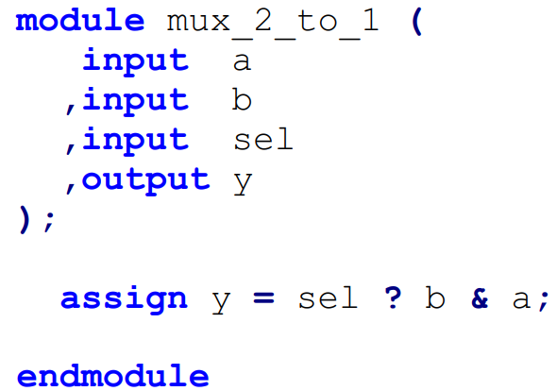



Exercise with SystemVerilog
Implementation of a MUX and simulation with Modelsim

Slide 40

Exercise with SystemVerilog*
Implementation of a MUX and simulation with Modelsim
Continuous assignment
wire signal
syntax: assign <signal> = <expression>;

Slide 41








Exercise with SystemVerilog*
Implementation of a MUX and simulation with Modelsim
Continuous assignment
wire signal
syntax: assign <signal> = <expression>;

Slide 42



Exercise with SystemVerilog
Implementation of a MUX and simulation with Modelsim
Continuous assignment
wire signal
syntax: assign <signal> = <expression>;
Ternary operator
<condition> ? <if true> : <if false>
sel ? … → sel == 1 ? …
Non-zero value = true
Zero value = false

Slide 43
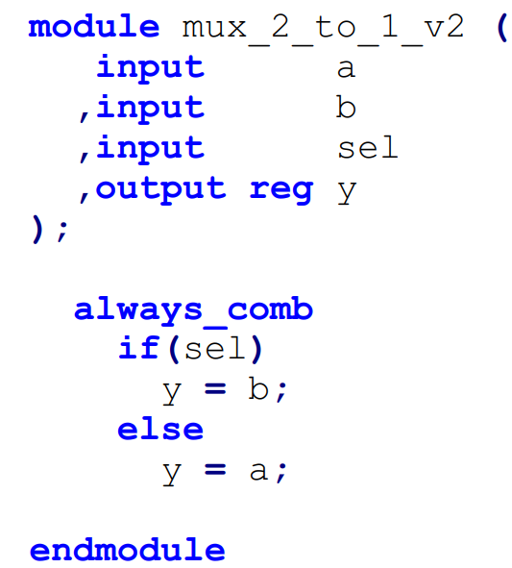

Exercise with SystemVerilog*
Implementation of a MUX and simulation with Modelsim
Blocking assignment
reg signal
always_comb block
operator =

Slide 44









Exercise with SystemVerilog*
Implementation of a MUX and simulation with Modelsim
Blocking assignment
reg signal
always_comb block
operator =

Slide 45



Exercise with SystemVerilog
Implementation of a MUX and simulation with Modelsim
Blocking assignment
reg signal
always_comb block
operator =
if-else statement:
if (<condition>)
<assignment>
else
<assignment>

Slide 46
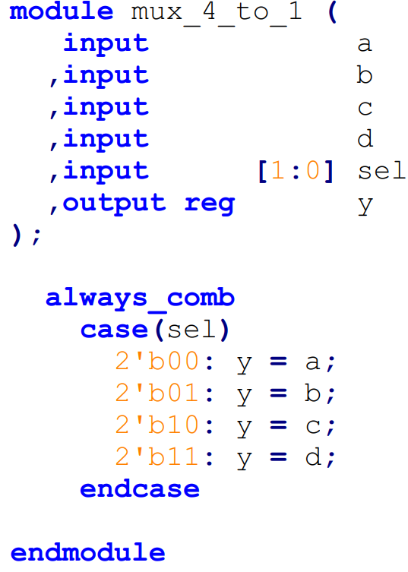


Exercise with SystemVerilog
Implementation of a MUX and simulation with Modelsim
case statement:
case (<signal>)
<case value 1> : <assignment>;
<case value 2> : <assignment>;
…
endcase

Slide 47
Exercise with SystemVerilog
Implementation of a MUX and simulation with Modelsim
case statement:
case (<signal>)
<case value 1> : <assignment>;
<case value 2> : <assignment>;
…
endcase
if not all the cases are specified, the default case must be included:
…
default: <assignment>;
endcase

Slide 48





Exercise with SystemVerilog
Implementation of a MUX and simulation with Modelsim
Constants
syntax: <bit width>’<base><value>
examples:
2’b00
4’d0
16’hFA3E
…

Slide 49
Exercise with SystemVerilog
Implementation of a MUX and simulation with Modelsim
Constants
syntax: <bit width>’<base><value>
b = binary
d = decimal
h = hexadecimal

Slide 50
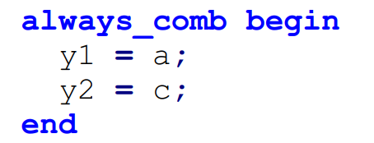
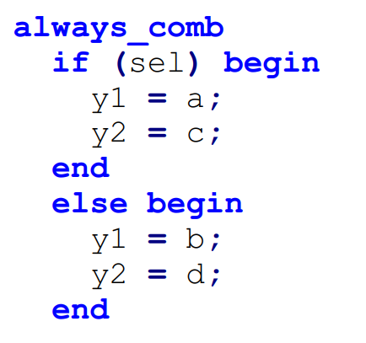
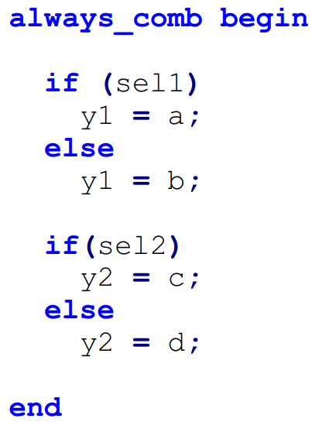
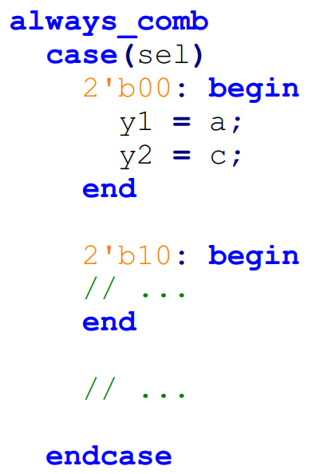
Exercise with SystemVerilog
Additional note
If any of the previous assignment blocks (i.e., always_comb, if-else, case value) contains more than one assignment, the begin – end delimiters must be used

Slide 51
Exercise with SystemVerilog
Implementation of a MUX and simulation with Modelsim
You can find all the files about this exercise in the dedicated folder on the Team of the course
File > Electronics Systems module > Crocetti > Exercises > 2.1
Try to simulate the different implementations of the MUX with Modelsim
Refer to Lecture 1.2

